Slide 1

Marrow & Salt
An independent bakery and restaurant opening a second location, funded by the winter menu's early performance.
Marrow & Salt

Slide 2
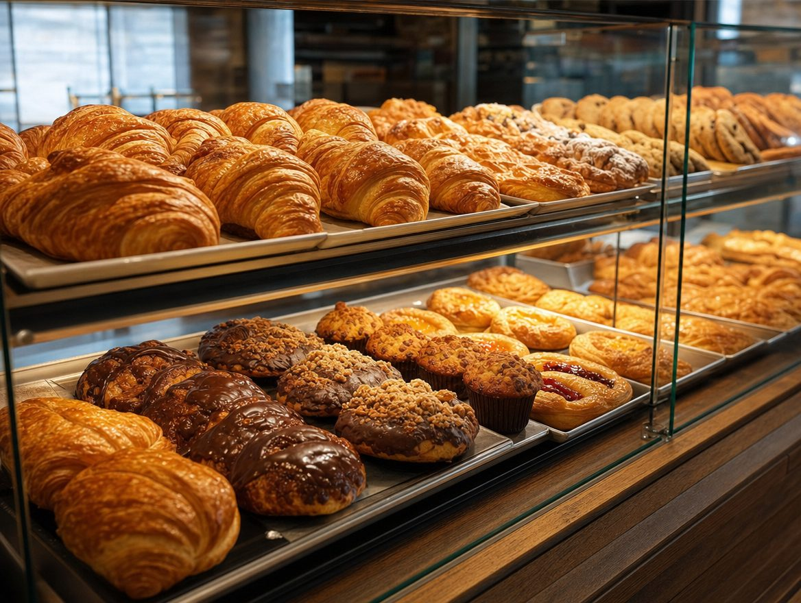
The room
Marrow & Salt

Slide 3
Unit economics
Average check: $34
Food cost: 29% of menu price
Break-even at 62 covers/day; currently averaging 71
Marrow & Salt

